Slide 1

Wireless Networking
Ambuj Varshney
Assistant Professor, National University of Singapore
Wireless, Embedded Intelligence, Sensing, and Emerging Technologies Group
ambujv@nus.edu.sg

Slide 2
Administration and Course Logistics

Slide 3
Assignment 3a (no assignment 3b)
Link: https://weiserlab.github.io/ambuj/cs4222_assignment3a
Deadline :2nd of April 2023/ CANVAS submission page is live
Covers: 13% of overall grade
Wireless measurements using RSSI
No Plagiarism! We will check for code similarity
No ChatGPT for this assignment
Notes:
++ We may all have heard of the term Internet of Things. So how are these wireless embedded systems related to the Internet of Things: Today, IoT includes a broad class of devices, including powerful platforms such as smartphones. However, it also includes more resource-constrained devices and what we call Wireless Embedded Systems, and in fact, I consider it to be one of the essential parts of the IoT ecosystem.
++ These are platforms equipped with a radio transceiver, sensor, microcontroller, and some form of energy storage. These platforms also often form a network, and sensor network as it is called has been an active area of research for the past two decades.
++ The research community has also developed wireless embedded platforms which we may know about, and these include: CMUCAM, which is an image sensor platform developed at Carnegie Mellon University, or Permamote is long life sensor platform from the lab I am associated with at UC Berkeley or Lorea which is a long-range backscatter platform that I had developed as part of my doctoral dissertation at Uppsala University. All of these are an example of Wireless Embedded Systems.

Slide 4
Project
We decided to integrate some aspects of assignment 3b with Project
Deadline: 21st April 2023/ With penalty (10%) 28th April 2023
Should be done in a group
Notes:
++ We may all have heard of the term Internet of Things. So how are these wireless embedded systems related to the Internet of Things: Today, IoT includes a broad class of devices, including powerful platforms such as smartphones. However, it also includes more resource-constrained devices and what we call Wireless Embedded Systems, and in fact, I consider it to be one of the essential parts of the IoT ecosystem.
++ These are platforms equipped with a radio transceiver, sensor, microcontroller, and some form of energy storage. These platforms also often form a network, and sensor network as it is called has been an active area of research for the past two decades.
++ The research community has also developed wireless embedded platforms which we may know about, and these include: CMUCAM, which is an image sensor platform developed at Carnegie Mellon University, or Permamote is long life sensor platform from the lab I am associated with at UC Berkeley or Lorea which is a long-range backscatter platform that I had developed as part of my doctoral dissertation at Uppsala University. All of these are an example of Wireless Embedded Systems.

Slide 5
Tutorials
Mandatory tutorial this week: Covers LPWANS, Neighbour discovery
Next two weeks: Optional (NO Attendance)/ Open session
Last week: Sample examination questions discussions/ Open session
Video lectures: Would make sure to record and upload by mid of next week
Notes:
++ We may all have heard of the term Internet of Things. So how are these wireless embedded systems related to the Internet of Things: Today, IoT includes a broad class of devices, including powerful platforms such as smartphones. However, it also includes more resource-constrained devices and what we call Wireless Embedded Systems, and in fact, I consider it to be one of the essential parts of the IoT ecosystem.
++ These are platforms equipped with a radio transceiver, sensor, microcontroller, and some form of energy storage. These platforms also often form a network, and sensor network as it is called has been an active area of research for the past two decades.
++ The research community has also developed wireless embedded platforms which we may know about, and these include: CMUCAM, which is an image sensor platform developed at Carnegie Mellon University, or Permamote is long life sensor platform from the lab I am associated with at UC Berkeley or Lorea which is a long-range backscatter platform that I had developed as part of my doctoral dissertation at Uppsala University. All of these are an example of Wireless Embedded Systems.

Slide 6
Review of Last Lecture

Slide 7
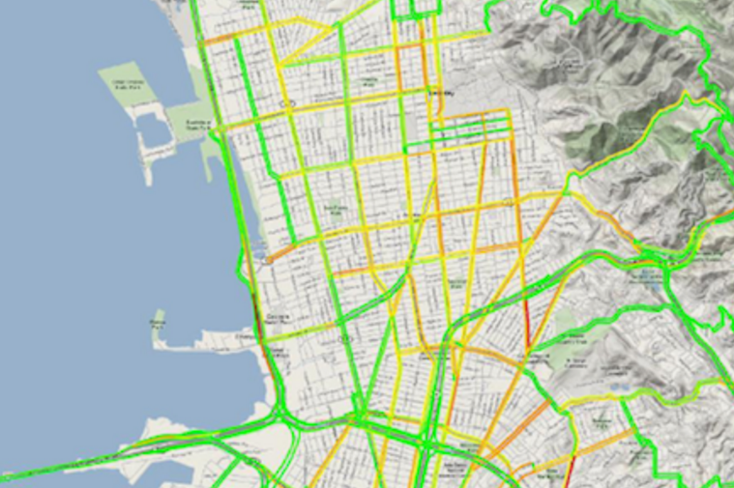
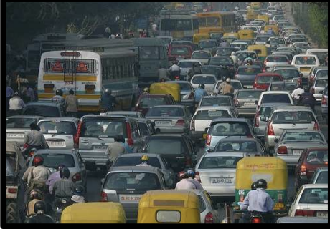
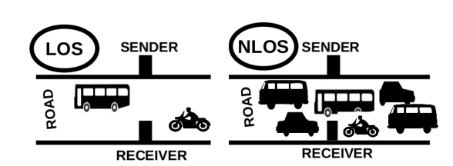
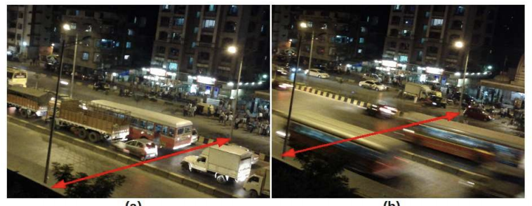
Traffic queue sensing and congestion control
[1]
[1]
[1]
[1] Sen et al. Kyun Queue: A Sensor Network System To Monitor Road Traffic Queues, 2012

Slide 8
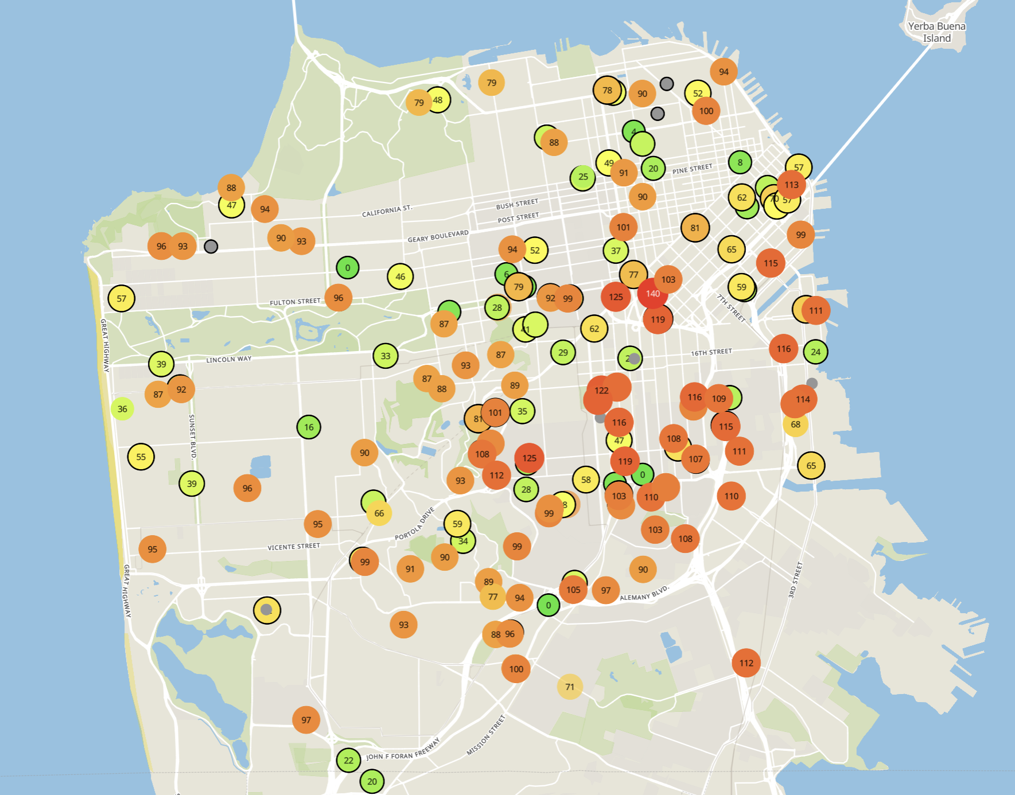
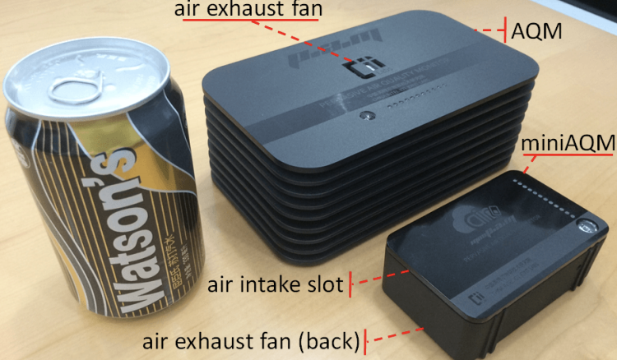
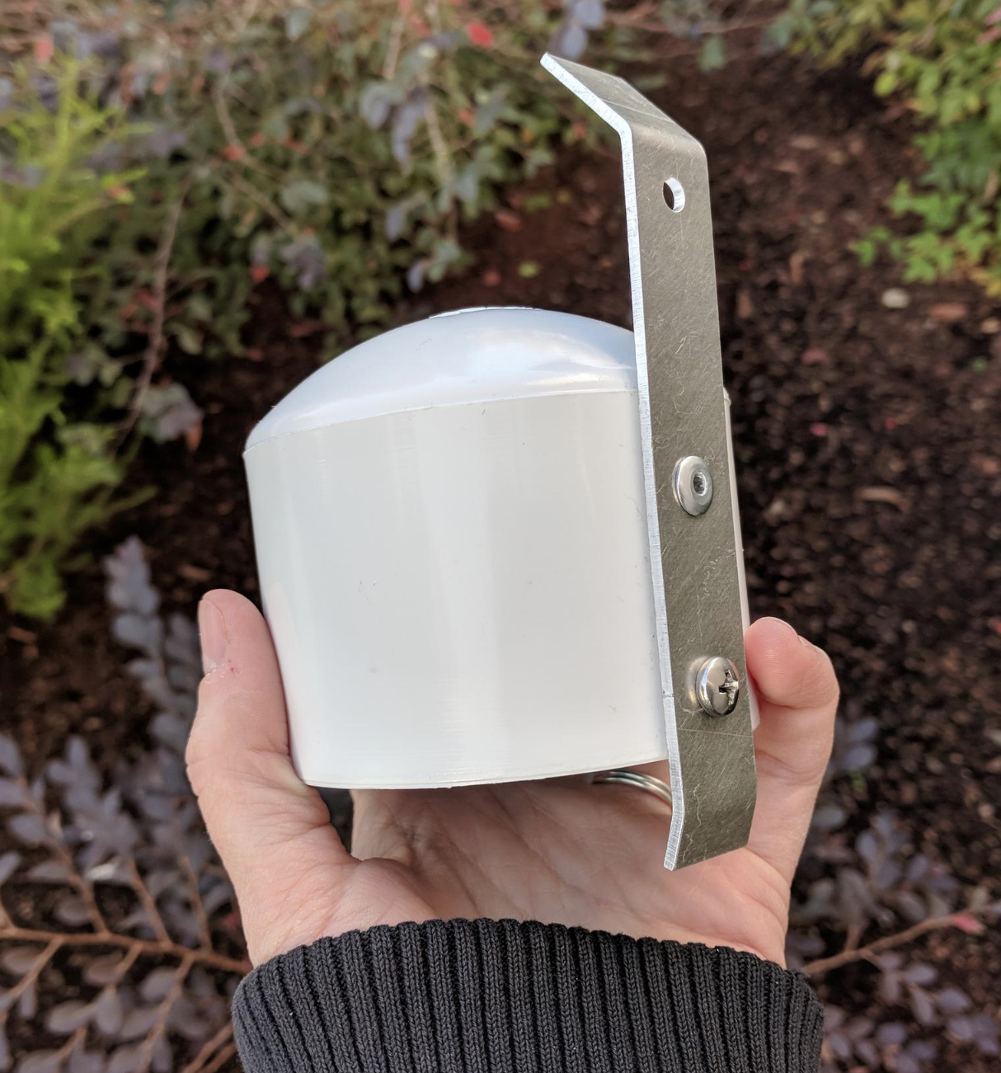
Example application: air quality monitoring
[1]
[2]
[2]
[1] Cheng et al. AirCloud: a cloud-based air-quality monitoring system for everyone. 2014. [2] Purple Air. 2019.

Slide 9
We need another network option
Requirements:
Wide area of coverage
Deploy fewer gateways
Low power
So we can deploy on batteries
Doesn’t need high throughput
Sensor data is relatively small

Slide 10
Long-range,low-data needs are not easily met
WiFi
4G
Higher Power & Higher Cost
3G
Data
Throughput
Bluetooth
2G
Low-Power Wide-Area Networks
BLE
Zigbee
Lower Power & Lower Cost
Range

Slide 11
Long-range, Low-power: design choices
How would you design PHY for long-range, low-power ?
Modulation
Unclear. Perhaps, not complicated or complex (simple devices)
Tx Power
High (much higher than 0 dBm)
Carrier Frequency Band
Low (something lower than 2.4 GHz, 915 MHz or lower?)
Data Throughput
Low (much lower than 1 Mbps)
Channel Bandwidth
Unclear. Likely smaller for lower frequency carrier.

Slide 12
Design a low-power wide-area network
Any particular MAC choices for lower power?
Diversity of devices in network
High power gateway, low power devices in star topology
Devices should be off whenever possible
Listen-after send for downlink
Remove requirements for synchronization
No TDMA access control if it can be avoided
Aloha, CSMA

Slide 13
Long-range CSMA is problematic
Long-range makes everything more challenging
Kilometers of range mean kilometers between devices
Detection of channel use is less reliable
Active research in clear channel assessment for LPWANs
Hidden terminal problem has a wider range
Might make RTS/CTS more important
Result: CSMA doesn’t dominate LPWANs like it does WLANs

Slide 14
LPWANs overview (common qualities)
Unlicensed 915 MHz band (902-928 MHz)
Higher power transmissions: ~20 dBm (100 mW)
Low data rate 100 kbps or less
Range on the order of multiple kilometers
Simple Aloha access control

Slide 15
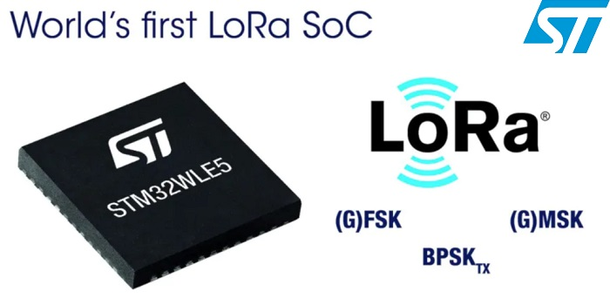
LoRaWAN
Open communication standard built with proprietary LoRa PHY
Operates in the unlicensed band
Low data rate (1-20 kbps) and long range (~5 km)
Most popular LPWAN protocol
Academic research and industry involvement

Slide 16
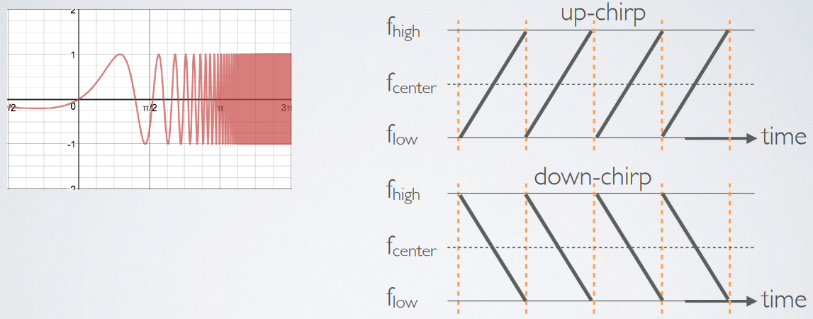
LoRa employs a different modulation scheme
Chirp Spread Spectrum (CSS): Modulation technique where frequency is varied linearly from lowest to highest within a channel

Slide 17
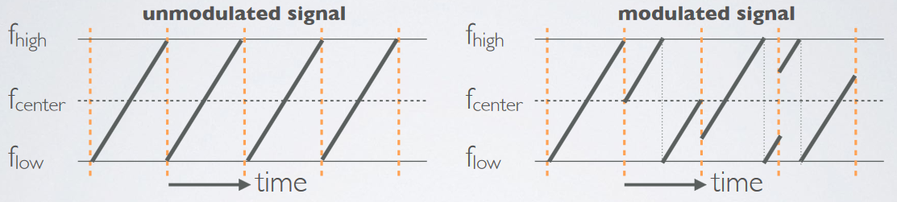
Chirp Spread Spectrum
Data is modulated in the starting and ending points of chirp
Frequency increases linearly, modulo bounds of the channel

Slide 18
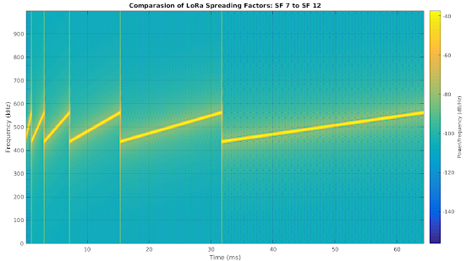
Spreading factor of CSS modulation
Spreading Factor is essentially the rate-of-change of frequency
Slope of the line
Lower values of spreading factor (steeper slope) are faster data rate
Important: different spreading factors are (mostly) orthogonal!
Two can overlap in time, space, and channel without a collision

Slide 19
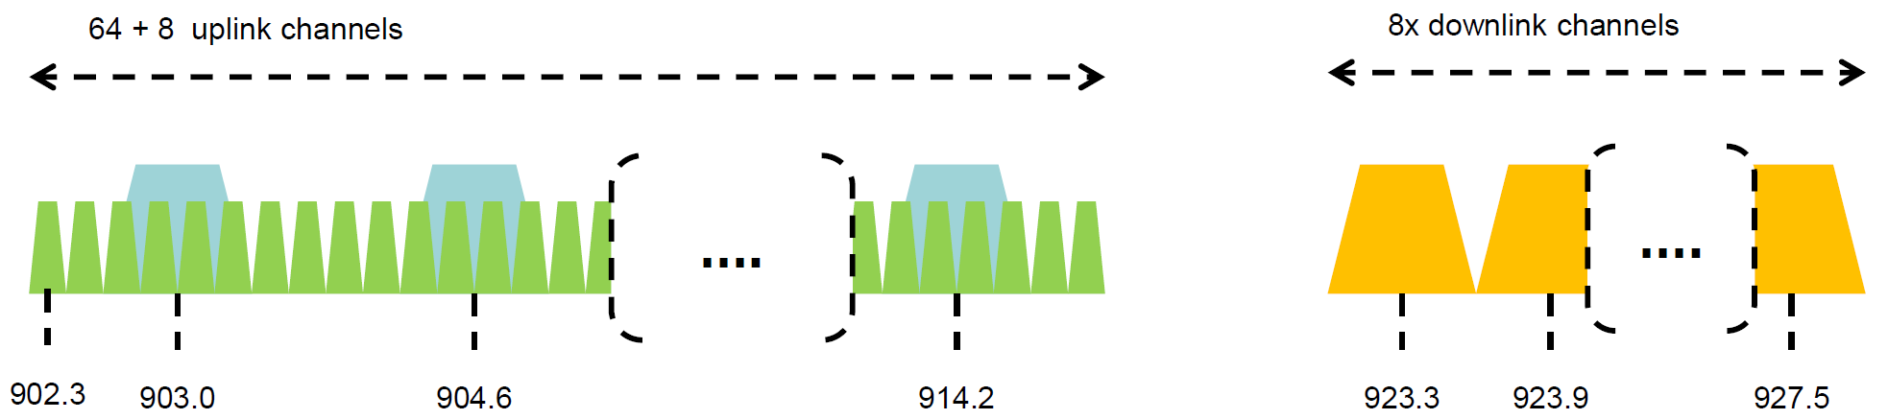
Channel allocation for LoRa
Sixty-four, 125 kHz uplink channels
Frequency Hopping over the 64 uplink channels
Plus eight, 500 kHz overlapping uplink channels (not well used in practice)
Eight, 500 kHz downlink channels

Slide 20
LoRa data rates
Data Rate Index | Spreading Factor | Bit Rate
125 kHz Uplink Rates
0 | SF10, 125 kHz | 980 bps
1 | SF9, 125 kHz | 1760 bps
2 | SF8, 125 kHz | 3125 bps
3 | SF7, 125 kHz | 5470 bps
500 kHz Uplink Rates
4 | SF8, 500 kHz | 12500 bps
500 kHz Downlink Rates
8 | SF12, 500 kHz | 980 bps
9 | SF11, 500 kHz | 1760 bps
10 | SF10, 500 kHz | 3900 bps
11 | SF9, 500 kHz | 7000 bps
12 | SF8, 500 kHz | 12500 bps
13 | SF7, 500 kHz | 21900 bps
Data rate depend on channel in use, spreading factor
64-channel uplink
1-5 kbps data rate

Slide 21
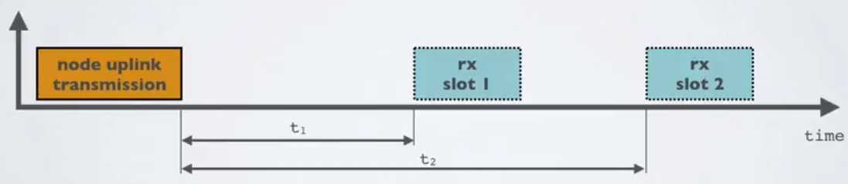
LoRaWAN MAC
Uplink: Aloha - transmit whenever
Randomly split across 64 uplink channels (reduced odds of collision)
Devices a different spreading factors also do not collide
Packets are very long though: up to 400 ms in duration
Downlink: listen-after-send (class A device)
Two windows for RX on different channels

Slide 22
LoRa transmissions are received on gateway
No synchronization with the end devices
Instead listen to entire bandwidth simultaneously (12 MHz total)
Recognize preambles and allocate a hardware to decode packet
Normal gateways: 8 decoders/ Good gateways: 64 decoders

Slide 23
LoRa link budget and transmission range
Typical TX power 20 dBm
Up to 30 dBm for 64-channel hopping
Up to 26 dBm for 8-channel hopping
Receive sensitivity -119 dBm/-146 dBm (highest SF)
Compare to -100 dBm for 802.15.4 and -95 dBm for BLE
Resulting range is kilometers in urban environments

Slide 24


LoRaWAN network providers
Network provides with a deployment of gateways
The Things Network (predominantly in Europe)
Helium
Any can buy and install their own gateway, which serves everyone
Microtransactions to pay for communication

Slide 25

Sigfox
Very low-rate (600 bps), very long-range (10+ km) communication
Star-topology networks, with always-listening gateways
Any number of low-power end devices
Uplink-focused communication
Applications: very low-rate metering

Slide 26
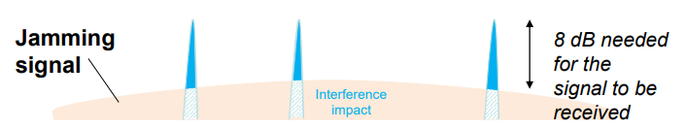
Sigfox PHY
Unlicensed-band communication
Europe 868 MHz. US 902-928 MHz (915 MHz band)
Ultra-narrowband 600 Hz (100 Hz Europe) channel bandwidth
Detection only needs to occur at very specific frequency
Helps improve signal-to-noise ratio

Slide 27
Sigfox unbalanced uplink and downlink
Uplink
600 Hz bandwidth, 600 bps, DBPSK
Downlink
1.5 kHz bandwidth, 600 bps, GFSK
Particularly optimized for Europe
Uplink on 1% duty cycle channel, up to 14 dBm
Downlink on 10% duty cycle channel, up to 27 dBm
Works fine in US too
Gets more power (24 dBm up is typical, up to 32 dBm down) and more range

Slide 28
Sigfox link budget
Why transmit at 100-600 bps?
For greatly increased link budget
Link budget: 150-160 dBm
Assuming Tx at ~20 dBm
Means Rx Sensitivity of -130 dBm (10 dBm better than LoRaWAN)
Resulting range: 10-15 km in urban environments
Except that buildings lead to dead spots in range

Slide 29
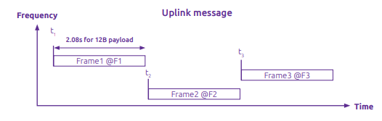
Sigfox MAC
Aloha-style access control (send whenever)
No acknowledgements!
Send message three times for increased reliability
Then listen for downlink at a set period later on a known frequency

Slide 30
Sigfox deployments
Proprietary network with managed deployment
Like cellular networks
Sigfox deploys networks and transports data
140 uplink messages plus 4 downlink message per day
Connectionless communication
Devices are registered with the networks
Keys are provided in the software image
Any deployed Sigfox gateway can collect transmitted data
Enables mobile applications

Slide 31
IEEE standard for LPWANs
n.b.
802 = “area networking”
.3 = “LANs”
.11 = “Wireless LANs”
.15 = “PANs”
802.11ah (HaLow) standard in 2016
First real hardware in 2020
Still not in real-world use yet
Focus on the indoor-to-outdoor scenario
Medium range (maximum 1 km)
915 MHz communication
NOT interoperable with other 802.11 access points and devices
Theoretically up to 356 Mbps
Practically, most devices are expected to implement 150 kbps to 8 Mbps

Slide 32
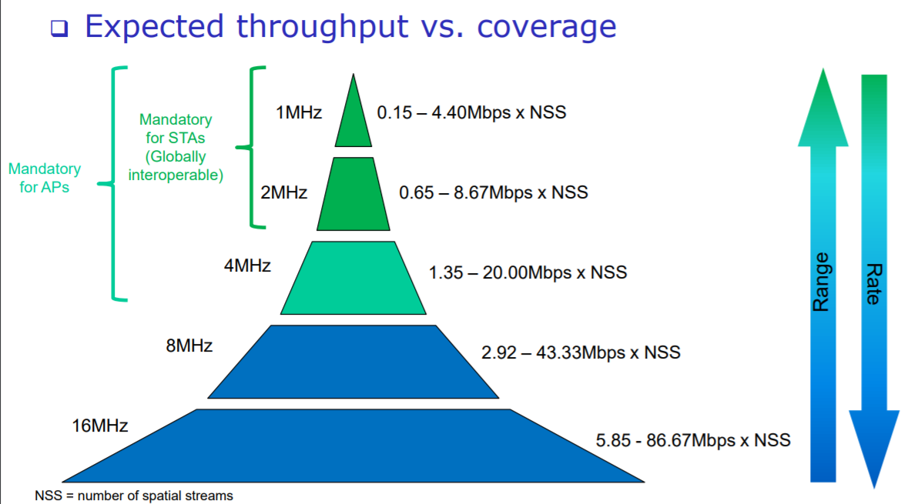
802.11ah allows multiple bandwidth allocations

Slide 33
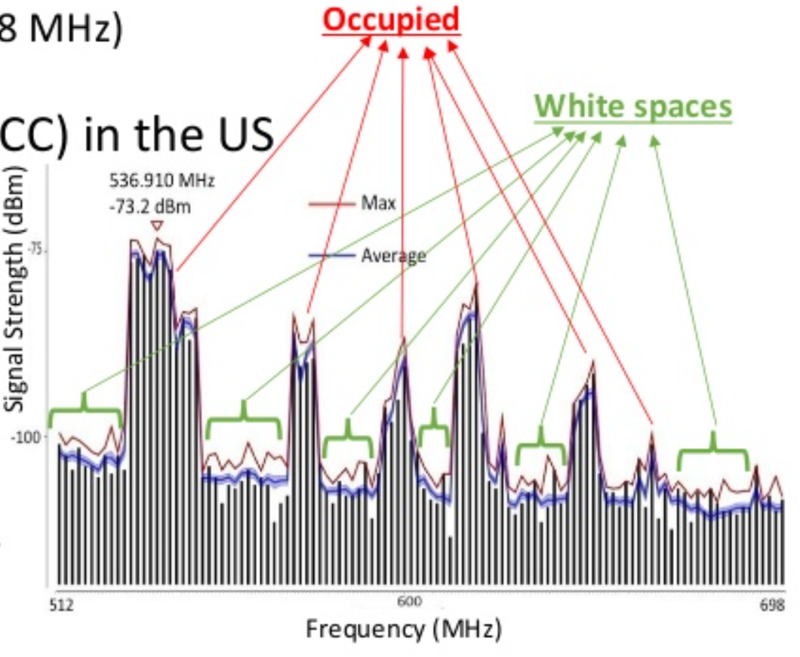
TV whitespaces
Unused TV channels between 54 MHz and 698 MHz
VHF (54-216 MHz)
UHF (470-698 MHz)
6 MHz channel width
Allocated but unused
FCC allows unlicensed use
IF you do not interfere with primary users

Slide 34
Sensing channel use
Variation in use
Spatial: Cannot assume same channel will be free everywhere
Temporal: Cannot assume channel will be free at all times
Cognitive radio approach
Dynamically identify unused portions of spectrum
Database approach
Let someone else do the scanning. Consult database based on location and time

Slide 35
Learning Objective for Today’s Lecture
Review: last few lecture’s topics
Bluetooth: Basics
Bluetooth: Advertising
Bluetooth: Connections
Bluetooth: Future
802.15.4: Review
Thread
ZigBee

Slide 36
Basics of Bluetooth Low Energy (BLE)
Direct device-to-device communication
Usually: Computer to Thing
Smartphone to device, Laptop to device, etc.
Focus on making the “Thing” really low energy
Push energy-intensive requirements onto “Computer”

Slide 37
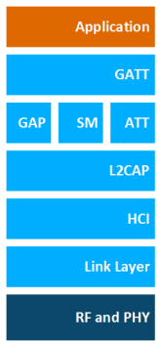
BLE Layers
GAP
Host – Configuration and Server
GAP – Generic Access Profile
Configure advertising
GATT – Generic Attribute profile
Configure connections
HCI - Host Controller Interface
Controller - Communication
Link Layer – send packets
RF and PHY – send bits
Host
Controller

Slide 38
Two different communication modes in BLE
Advertising
Discovery
Advertisements – broadcast messages indicating device details
Ephemeral, uni-directional communication from Advertiser to Scanner(s)
ALOHA access control
Connections
Interaction
Bi-directional communication between Peripheral and Central
Maintained for some duration
TDMA access control

Slide 39
BLE network topology
Peripheral
Connection
Central & Scanner
Scanner
Connection
Peripheral
Advertisement
Advertisement
Advertisement
Advertisement
Advertiser
Advertiser
Advertiser

Slide 40
Bluetooth devices multiple roles at the same time
Topology picture is a simplification of roles
A single device can have multiple roles simultaneously
Scanning and Advertising simultaneously
Peripheral and Scanner and Advertiser simultaneously
Peripheral and Scanner and Central and Advertiser simultaneously
Also possible:
One Peripheral can be connected to multiple Central

Slide 41
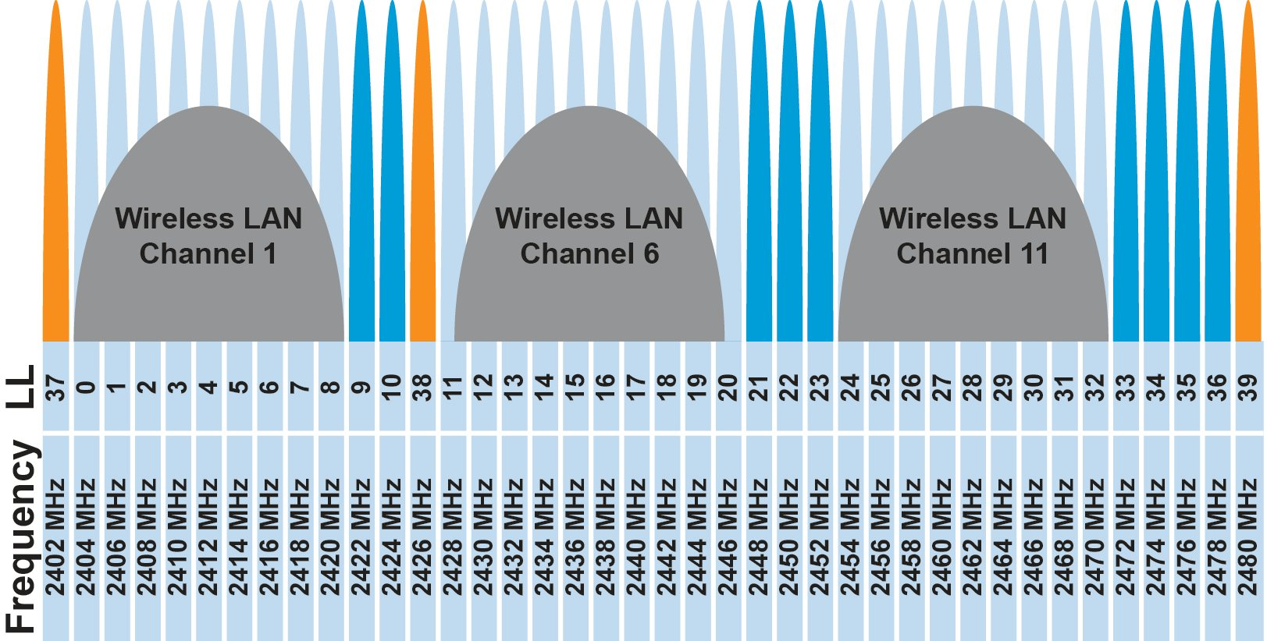
BLE frequency
2.4 GHz carrier, Forty 2-MHz channels, 1 Mbps data rate
37, 38, 39 for advertising
0-36 for connection (FHSS)

Slide 42
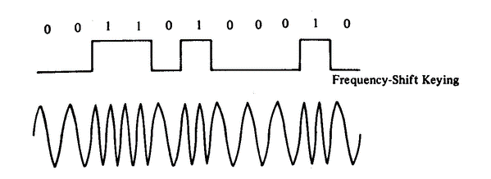
BLE modulation
Gaussian Frequency-Shift Keying (GFSK)
Improvement on base Frequency-shift Keying
Smoother transitions between bits -> reduces nearby interference

Slide 43
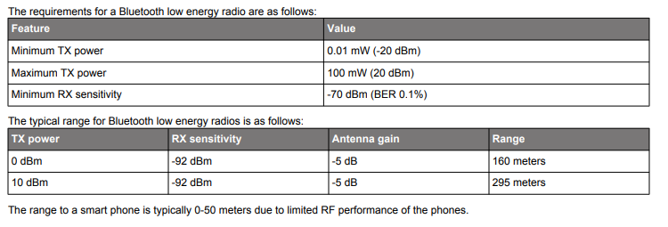
BLE signal strength
What are capabilities of CC2650?

Slide 44
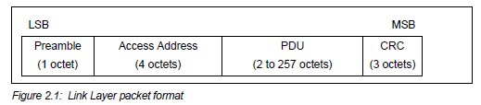
Packet structure
Same packet structure for both advertisements and connections
Fields are filled in little endian (the opposite of network byte order )
Access address unique for each connection (randomly chosen)
In Advertising always set to 0x8E89BED6

Slide 45
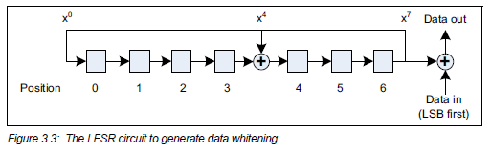
Whitening the data bits
Avoid long series of repetitive bits (all zeros or all ones)
Would cause RF noise to be more focused in one direction
Radio hardware desires output to have zero DC-bias (or close to that)
Great example of the PHY and MAC being interwoven in wireless

Slide 46
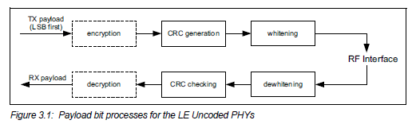
Bit processing pipeline

Slide 47
Learning Objective for Today’s Lecture
Review: last few lecture’s topics
Bluetooth: Basics
Bluetooth: Advertising
Bluetooth: Connections
802.15.4: Review
Zigbee
Thread

Slide 48
Advertising
BLE discovery mechanism
Make nearby devices aware of advertiser’s existence
Communicate some information from or about advertiser
Traditional purpose is to enable connections, but this is also useful for general communication
Advertisements
Periodic broadcast messages with data
Scan Requests/Responses
Scanner sends responses after getting a request
Only occurs when scanner is listening

Slide 49
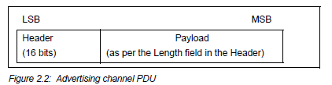
Advertising packet layering

Slide 50
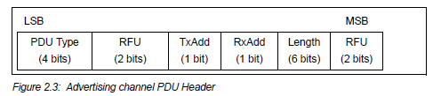
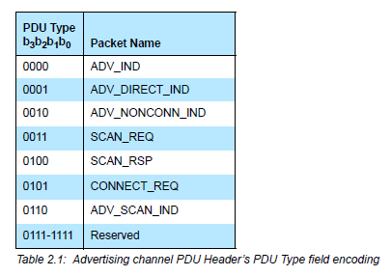
BLE advertising header
ADV_IND
Advertisement
Allows connections and scan requests
ADV_NONCONN_IND
Advertisement
No connections or scan requests
ADV_SCAN_IND
Advertisement
No connections but allows scan requests
SCAN_REQ
Scan request
SCAN_RSP
Scan response

Slide 51
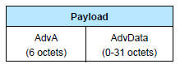
Advertisement payloads
AdvA – address of the advertiser
TxAdd bit from header specifies if this is a “public” or “random” address
Remaining up to 31 bytes are available for use
Putting it all together, up to 47 bytes total:
BLE Packet
Advertising PDU
Preamble 1 Byte | Access Address 4 Bytes | Header 2 Bytes | Advertiser Address 6 Bytes | Advertiser Data (Payload) 0-31 Bytes | CRC 3 Bytes

Slide 52
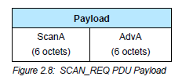
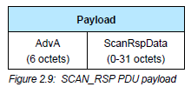
Scan Requests and Responses
Scan request
Just the two addresses: the scanner’s and the advertiser’s
Scan response
Identical to an advertisement
But only occurs after a request

Slide 53
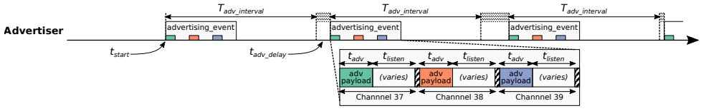
Advertising timing
Advertising Events occur periodically [20ms – 10.24 s] (or longer)
Plus a random delay after each instance [0-10ms]
Why?
User picks the rate as a tradeoff of energy and discovery latency

Slide 54
Advertising timing
Advertising Events occur periodically [20ms – 10.24 s] (or longer)
Plus a random delay after each instance [0-10ms]
Why? Collisions
User picks the rate as a tradeoff of energy and discovery latency

Slide 55
Advertising event
Three transmissions, one on each advertising channel
Always in the same order
Transmission, followed by listening window on that same channel
Requests will be sent >=150 us (Inter-Frame Spacing, IFS) after Tx
Followed by a retune to the next channel frequency
Short listen window to enable low-power operations

Slide 56
Preserving energy in communication
Most energy is spent listening
This is due primarily to how long listening durations are compared to transmissions
Example: maximum-sized BLE transmission:
8 bits/byte * 47 bytes = 376 bits at 1 Mbps = 0.376 ms transmitting
So listening for an entire second is >2500 times longer
But listening for only 0.376 ms requires sub-ms synchronization, which itself costs energy to manage…
Instead, when advertising, nRF radios listen for ~0.200 ms, only after a transmission

Slide 57
Payload of an advertisement
BLE payload?
Theoretically whatever you want, but that isn’t very compatible
Point is to specify capabilities of the advertiser
Desire: specify payloads in such a way that all scanners can interpret what they mean about the device
This is different from traditional internet packets
Broadcasts are for _anyone_ to hear, not a specific server/application
Ideas?

Slide 58
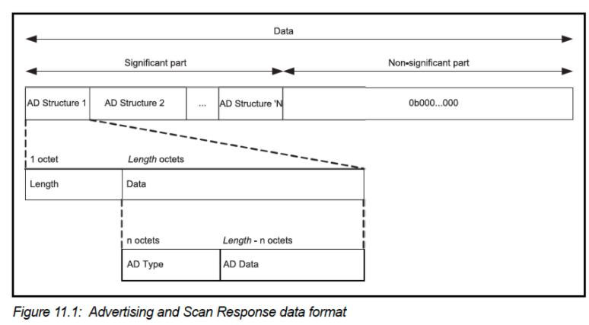
TLV Format
Type – Length – Value
Actually, BLE does the length part first
Scanner can hop through length/type pairs to find what interests it

Slide 59
Payload types
Listed in the Core Specification Supplement [Supplement v9]
Each might have their own considerations about AD Data format
Flags (supported modes: BLE and Bluetooth) required by Apple?
Name
Service UUID
TX Power Level
Manufacturer-specific data
And about twenty others

Slide 60
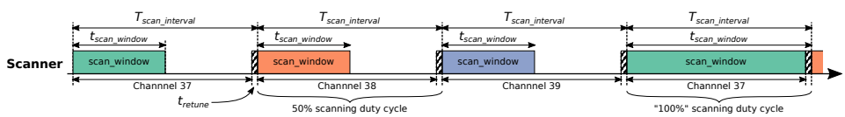
Scanning Pattern
Iterate through channels, listening for advertisements
T_{scan_interval} controls rate at which channels are changes
T_{scan_window} controls duty cycle of listening
Why listen at a low duty cycle?

Slide 61
Scanning Pattern
Iterate through channels, listening for advertisements
T_{scan_interval} controls rate at which channels are changes
T_{scan_window} controls duty cycle of listening
Why listen at a low duty cycle? Save energy

Slide 62
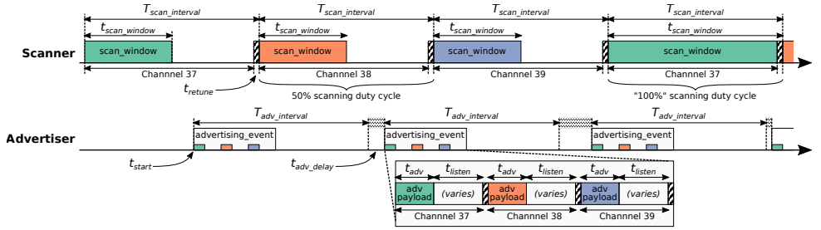
Putting it all together
Advertisements are received when the channel of the scan window and the channel of the advertisement overlap in time (and space)

Slide 63
Scanning expectations
Scanners will NOT receive 100% of packets sent
Packets are lost due to one or more of following:
Duty cycle
Sharing 2.4 GHz antenna with WiFi
Retune period after each scanning interval
Dropped packets in the receive software
Packet collisions

Slide 64
Advertisements are already being used for communication
BLE advertisements are uncoordinated, broadcast messages designed for discovery.
Devices are being deployed using advertisements.
Beacons – iBeacon
Tracking – Tile
Local communication – Apple Continuity
Notes:
PowerBlade is a great example of this.
It’s a plug-load power meter
Initially configured to use advertisements as a simple method for reading measurements with a smartphone
We are interested in household deployments where dozens of PowerBlades will be deployed to measure all the loads in a home
Can we still use BLE advertisements for data transfer in the presence of many other devices?

Slide 65
Beacons
Advertising with advertisements!
Web of Things
Real-world tags that broadcast virtual-world identifiers
iBeacon and Eddystone
Formats for sending URLs and device identifiers
Use existing BLE fields (Service Data and Manufacturer-Specific Data)

Slide 66
Tracking
Find devices nearby
Get a sense of distance to the device
Find my X
Tile: find my keys
Apple: find my device
Uses TX power level field
Lists the transmitted power of the device
Pathloss = TX power – RSSI (all in dBm)

Slide 67
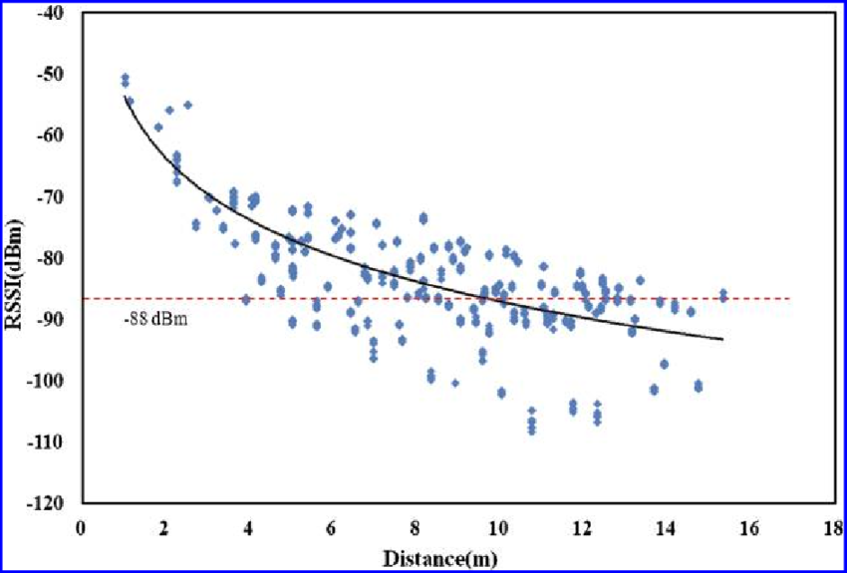
Problem with RSSI-based distance – not accurate
Pathloss is NOT only due to distance
RSSI is way worse at this than you hope it would be
Citation: literally everyone has made this figure at some point

Slide 68
Learning Objective for Today’s Lecture
Review: last few lecture’s topics
Bluetooth: Basics
Bluetooth: Advertising
Bluetooth: Connections
Bluetooth: Future
802.15.4: Review
Thread
ZigBee

Slide 69
Overview of connections
Connections are for bi-directional communication with higher throughput than advertisements
Simple view
A peripheral is either advertising or in a connection
A central is scanning and in one or more connections
(Remember: devices can have many roles simultaneously)
While in a connection both devices act like servers
Either device can read/write fields available on the other device

Slide 70
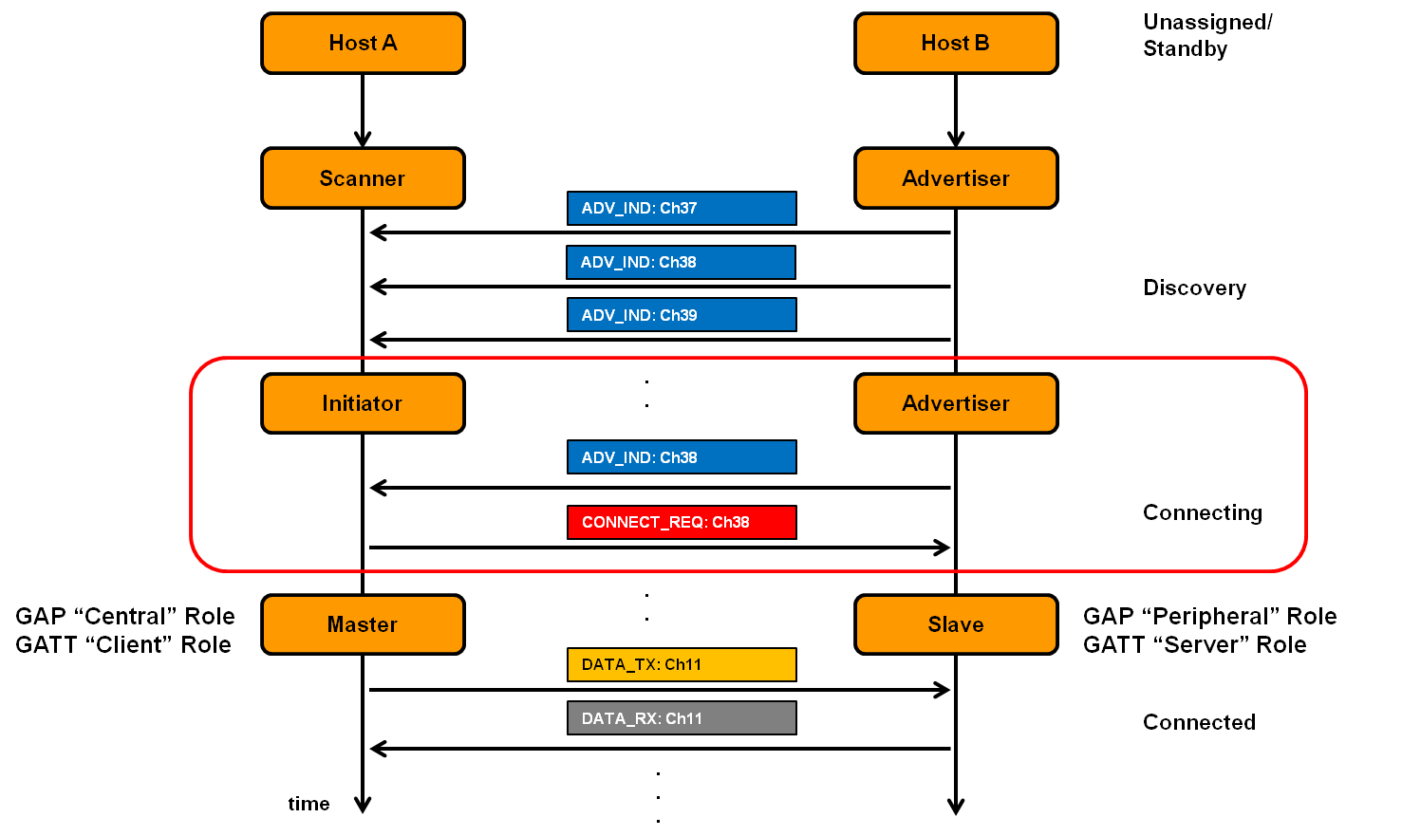
Connection timeline (in picture form)
Central
Peripheral

Slide 71
Connection timeline
Initiating a connection
Peripheral is sending broadcast advertisements
Central is scanning and receives an advertisement
Central sends connection request
During a connection
Central sends a packet each “connection interval”
Peripheral immediately responds with a packet
Multiple packets may be exchanged this way until done
Repeat at next connection interval
Ending a connection
Either device sends termination packet
Timeout occurs on either device

Slide 72
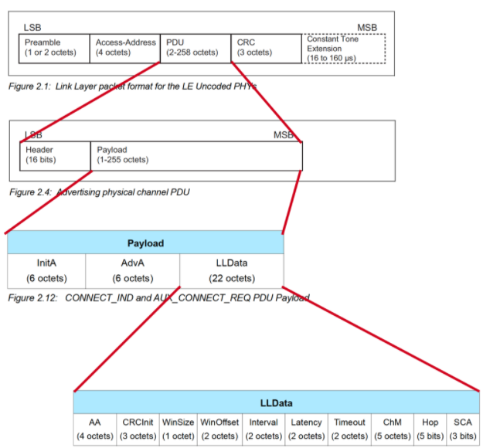
Connection request packet
Scanner waits until it sees an advertisement from a device it wants to connect to
Requesting a connection (in higher layers) just starts this search process
Sends connection request payload in response to advertisement

Slide 73
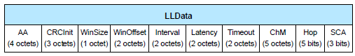
Request parameters
Specifies parameters of the connection
Peripheral must either agree or totally reject the connection
Peripheral can later propose a change to the connection parameters
Interval is how frequently connection events occur
Timeout is how long since hearing from before the connection breaks
Channel Map and Hop have to do with FHSS pattern

Slide 74
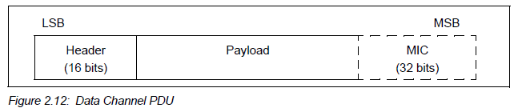
Data payloads
SDU – Service Data Unit
Logical packet that may be split into several physical packets
Channel ID
Destination for data
ATTributes or Security
Can also make custom endpoints
Length (16 bits) | Channel ID (16 bits) | L2CAP SDU Length* (16 bits) | Information Payload (0 to 249 octets)

Slide 75
Next steps in a connection
Control packets
Version
Bluetooth version, Company ID of Software Stack
Features
Various connection features supported by the device
Encryption, Ping, Channel selection algorithms, Various 5.0 features
Etc.
Extended packet length, Various 5.0 features (change PHY)
Various “procedures” for setting up changes in the connection
Data packets
Attribute discovery
Attribute reading

Slide 76
Ending connections
Termination control packet
Timeout parameter from connection parameters
Human-based devices may just wander away from each other
Or be shut off, or reprogrammed, etc.

Slide 77
Questions about Bluetooth “network”
How does TDMA MAC for connections work?
Implies a schedule
Implies synchronization
How many devices can be in a network?
How much throughput can a device have?

Slide 78
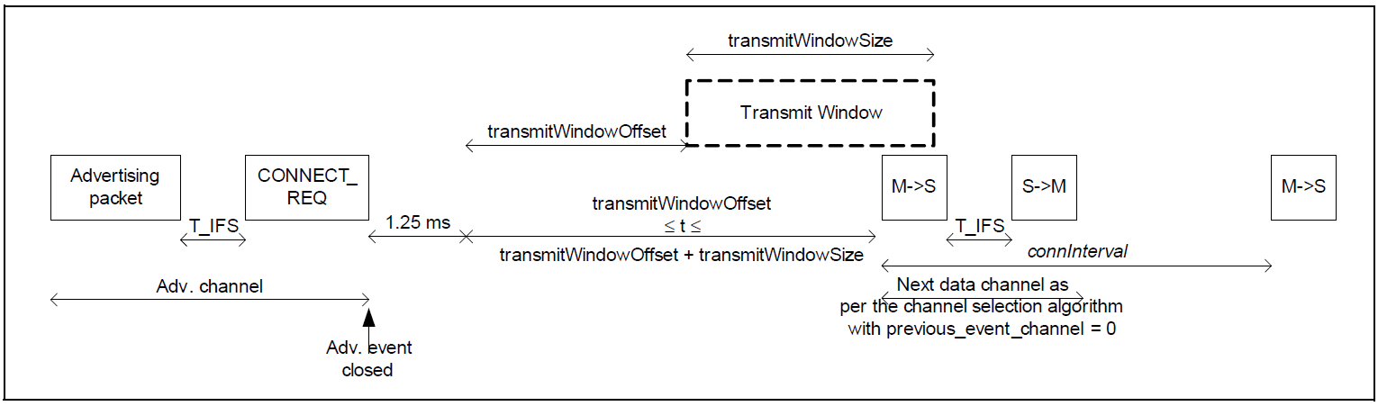
How is the TDMA schedule created/managed?
Only the central needs to know the schedule
It controls interactions with the peripheral(s) it is connected to
Anchor point and connection interval determines the schedule for a specific device
Central to Peripheral
Peripheral to Central
Central to Peripheral

Slide 79
How is synchronization managed?
Central sends first packet at each connection interval
So peripheral must be synchronized to central
Resynchronization can occur on each received packet
Specification describes how a peripheral must widen its listening window based on “Source Clock Accuracy”

Slide 80
How many devices can be connected?
We can schedule with granularity of at least 1.25 ms (offset steps)
That’s at least 800 devices per second
Intervals go up to 4 seconds, so multiply by four
That’s 3200 devices per max interval
Plus central can skip intervals on occasion without dropping the connection
And really the offset defines a window. More granularity is available
Answer: thousands of devices
Although each is sending minimum-sized packets each interval

Slide 81
How many devices can be connected in the real world?
The limit is much much lower on real devices
Example: Android sets a limit at around 4-15
nRF52 s140 softdevice allows up to 20
Connection management is often done in firmware
Softdevice for nRF, firmware on the radio chip in smartphones
Limited by memory and complexity

Slide 82
How much throughput can a device have?
1 Mbps?

Slide 83
How much throughput can a device have?
1 Mbps? Not even close. Packet overhead plus timing delays

Slide 84
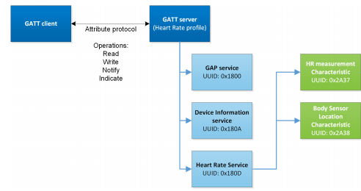
Overview of Generic Attribute Profile (GATT)

Slide 85
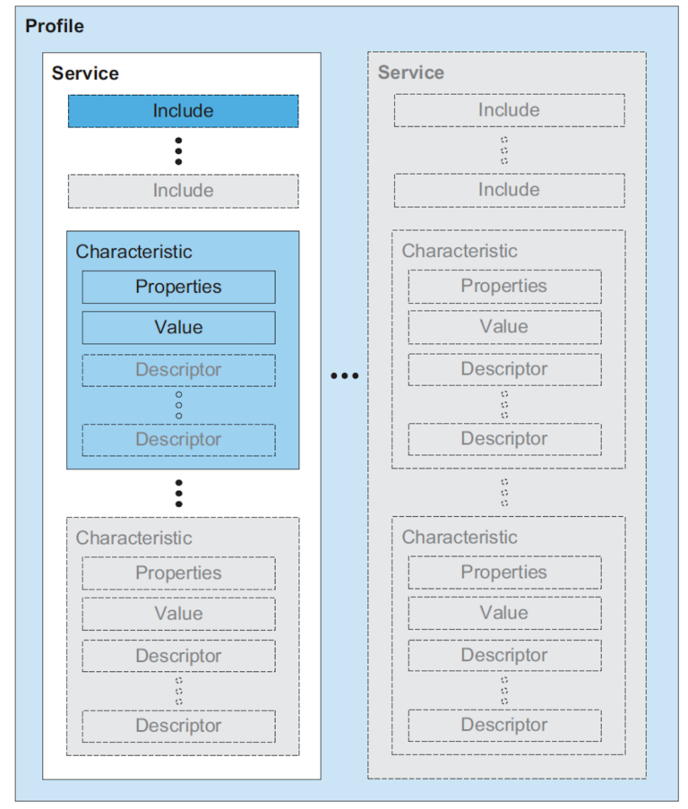
Attribute server keywords
Characteristic
A field with properties and a value
Descriptor: metadata about the characteristic
Service
Collection of characteristics
Profile
Collection of services

Slide 86
UUIDs and handles
Universally Unique Identifiers
128-bit, mostly random with a few bits for versioning
Example: 00000000-0000-1000-8000-00805F9B34FB
This is the default BLE UUID for known services
You can generate your own UUID for custom services
Handles
Too long to pass around all the time, so pick 16 bits that mean that UUID
Must be unique among services/characteristics on that device
Taken from UUID: 0000xxxx-0000-1000-8000-00805F9B34FB
Handle often sequentially incremented for each new characteristic within a service

Slide 87
Discovery
When a connection first occurs, each device can query the other for a list of services
And can further query for a list of characteristics in that service
Gets a list of handles/UUIDs
Standardized UUIDs can be interpreted immediately
Custom services/characteristics need documentation from the manufacturer

Slide 88
Learning Objective for Today’s Lecture
Review: last few lecture’s topics
Bluetooth: Basics
Bluetooth: Advertising
Bluetooth: Connections
Bluetooth: Future
802.15.4: Review
Thread
ZigBee

Slide 89
Changes in BLE 5
Major changes
Multiple physical layers
Advertising extensions
Localization extensions
Minor changes
Various quality of life improvements
Examples:
Advertise on channels in any order
Better data channel hopping algorithm

Slide 90
Revised physical layers
2 Mbps PHY
Transmit data faster
Transmit more data in the same time
Coded PHY
Forward Error Correction in the data stream
1 bit -> 2 symbols or 8 symbols
Makes bits more reliable -> longer distance
500 kbps and 125 kbps modes
Connections can switch to these PHYs after creation
Advertisements can use these with extensions only

Slide 91
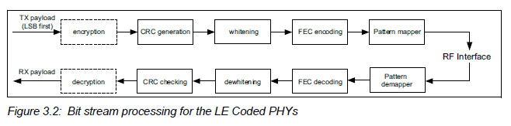
Revised processing path

Slide 92
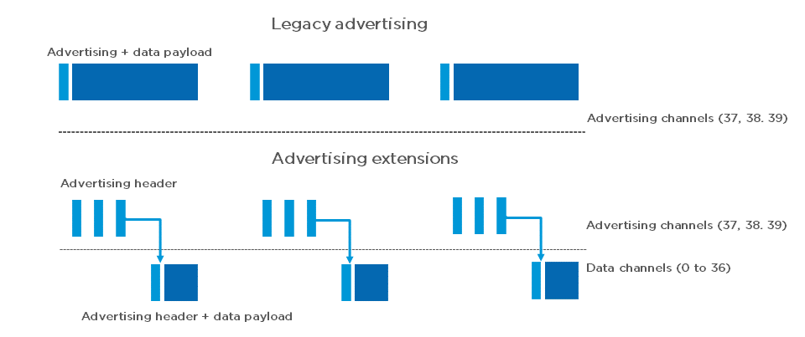
Extended advertising
Allow bigger payloads and/or different PHYs
Uses Data Channels to do so. Why?
Regular advertisements point to extended advertisements

Slide 93
Extended advertising
Allow bigger payloads and/or different PHYs
Uses Data Channels to do so. Why? Packet collisions!
Regular advertisements point to extended advertisements

Slide 94
Procedure for scanning extended advertisements
Scan on 3 primary channels for advertising packets.
If ADV_EXT_IND is scanned, record the secondary channel information (which channel and when etc.)
Scan the specific secondary channel at the given time.

Slide 95
Learning Objective for Today’s Lecture
Review: last few lecture’s topics
Bluetooth: Basics
Bluetooth: Advertising
Bluetooth: Connections
Bluetooth: Future
802.15.4: Review
Thread
ZigBee

Slide 96
802.15.4 Overview
Goals
Explicit support for low-cost, low-power, low-throughput devices
Focus on low complexity for specification
Only PHY and MAC are part of specification
Target home automation
Secondarily industrial control/monitoring, vehicular sensing, and agricultural uses

Slide 97
IEEE 802.15.4
Low-Rate Wireless PAN
250 kbps, ~100 m range
Radio hardware available with low-power and low-cost
Specification: 2003
Also 2006, 2011, 2015, and 2020 revisions
Mostly various added capabilities such as extra PHY layers
Also define optional security, scheduling, and larger frame sizes
We’ll mostly work off of the 2006 version
Thread is based on 2006 version
Zigbee is based on the original 2003 version
Roughly 200 pages of meaningful specification (100 of appendices)
Compare to 3000 pages of Bluetooth/BLE

Slide 98
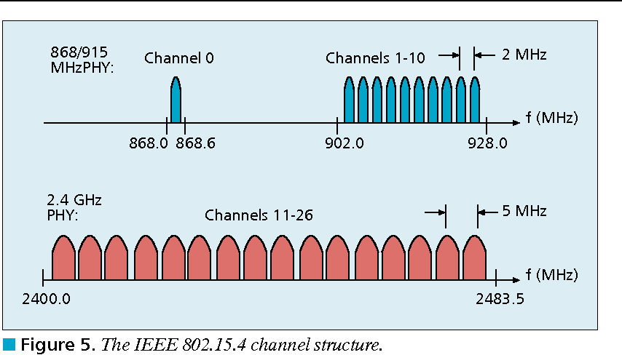
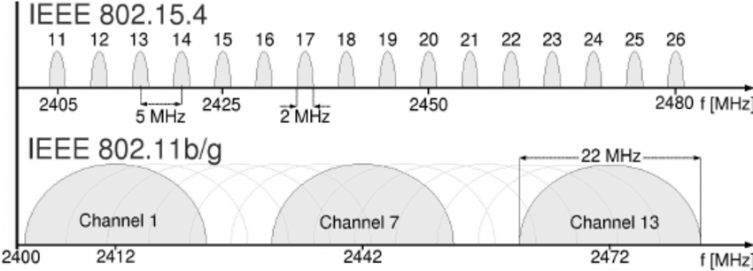
802.15.4 RF channels
27 channels across three bands
5 MHz channel separation at 2.4 GHz
Compare to 2 MHz for BLE

Slide 99
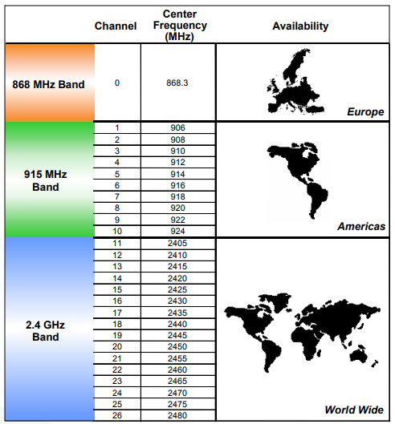
Regional bands
Different RF bands have different regional availability
Also have different rules
915 MHz: 400 ms dwell time
868 MHz: 1% duty cycle

Slide 100
Learning Objective for Today’s Lecture
Review: last few lecture’s topics
Bluetooth: Basics
Bluetooth: Advertising
Bluetooth: Connections
Bluetooth: Future
802.15.4: Review
Thread
ZigBee

Slide 101
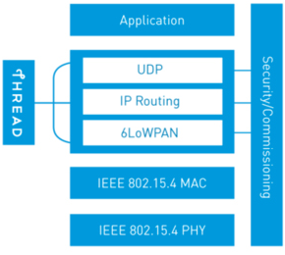
Thread overview
Build a networking layer on top of 15.4
Reuses most of PHY and MAC
Adds IP communication
Handles addressing and mesh maintenance
Goals
Simplicity – easy to install and operate
Efficiency – years of operation on batteries
Scalability – hundreds of devices in a network
Security – authenticated and encrypted communication
Reliability – mesh networking without single point of failure
Industry-focused, but based in academic research

Slide 102
Changes to Physical Layer
Remove all non-2.4 GHz PHY options
Otherwise the same
OQPSK
16 channels, 5 MHz spacing
Typical TX power 0 dBm
Typical RX sensitivity -100 dBm

Slide 103
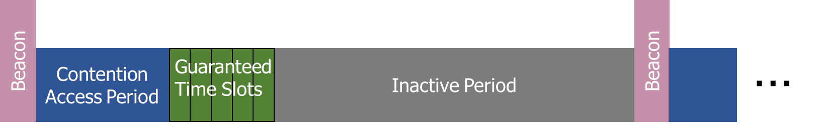
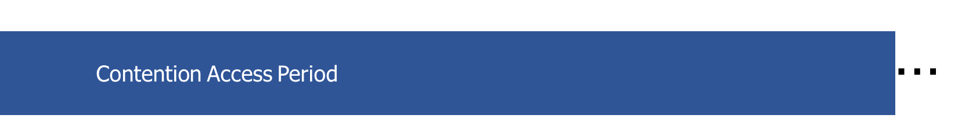
Changes to Link Layer and MAC
Non-beacon-enabled PAN only
No superframe structure
No periodic beacons
No Guaranteed Time Slots
Throw out most existing MAC Commands
Remove network joining/leaving
Remove changing coordinators
Remove Guaranteed Time Slot request
Network joining will be handled at a higher layer

Slide 104

Changes to Link Layer and MAC
Keep unslotted CSMA/CA algorithm
Keep packet structure
Keep Frame Types
Beacon
MAC Command
Beacon Request
Data Request
Data
Acknowledgement

Slide 105

Combination of star and mesh topology
Routers (parent)
Mesh communication with other routers
Radio always on
Forwards packets for network devices
Enables other devices to join network
32 routers per network
End devices (child)
Communicates with one parent (router)
Does not forward packets
Can disable transceiver to save power
Send packets periodically to avoid timeout
511 end devices per router

Slide 106

Router promotion
“Router Eligible End Device”
A router without any children
Can operate as an end device with one connection (lower power)
Promotes to a router when a joining end device relies on it
If there is room for an additional router (max 32, typical 16-23)

Slide 107

Other special roles
Thread leader
Device in charge of making decisions
Addresses, Joining details
Automatically selected from routers
One leader at any given time
Additional leader is selected if the network partitions
Border router
Router that also has connectivity to another network
Commonly WiFi or Ethernet
Provides external connectivity
Multiple border routers may exist at once

Slide 108
Thread uses IPv6 for communication
Why IP?
If Wireless Sensor Networks represent a future of billions of connected devices distributed throughout the physical world
Why shouldn’t they run standard protocols wherever possible?
Why IPv6?
Generalized, Flexible, Capable
Benefits
Interoperability with normal computers and networks
Reuse state of the art developed standards instead of remaking them
Security, Naming, Discovery, Services
Costs
Packet overhead can be high (will fix)
Complexity for supporting protocols
Hui and Culler, “IP is Dead, Long Live IP for Wireless Sensor Networks”. 2008

Slide 109
Background: IPv6
Replacement to Internet Protocol v4
Extended addressing for devices
32-bits for IPv4 addresses -> 128-bits for IPv6 addresses
Example: a39b:239e:ffff:29a2:0021:20f1:aaa2:2112
Supports multiple transmit models
Broadcast: one-to-all
Multicast: one-to-many
Unicast: one-to-one
Various other improvements

Slide 110
Background: IPv6 address notation rules
Groups of zeros can be replaced with “::”
Can only use “::” in one place in the address
Leading zeros in a 16-bit group can be omitted
0000:0000:0000:0000:0000:0000:0000:0001 → ::1
2345:1001:0023:1003:0000:0000:0000:0000 → 2345:1001:23:1003::
aecb:0222:0000:0000:0000:0000:0000:0010 → aecb:222::10
Special addresses
Localhost - ::1 (IPv4 version is 127.0.0.1)
Link-Local Network - fe80:: (bottom 64-bits are ~device MAC address)
Local Network – fc00:: and fd00::
Global Addresses – 2000:: (various methods for allocating bottom bits)

Slide 111
Background: IPv6 datagram format
Priority: like “type of service” in IPv4.
Flow label: ambiguous
Next header: TCP, UDP
Hop limit = TTL
version
priority
flow label
payload length
next header
hop limit
source address
(128 bits)
destination address
(128 bits)
data
(variable length, typically a TCP or UDP segment)
how much overhead?
40 bytes of IPv6
20 more than IPv4
32 bits

Slide 112
6LoWPAN
Method for running IPv6 over 802.15.4 links
IPv6 over Low-Power Wireless Personal Area Networks
IETF Standard (RFC4944 + updates in RFC6282)
Directly out of the research world (Jonathan Hui + David Culler)
Research Paper: IP is Dead, Long Live IP for Wireless Sensor Networks
Thesis of work: sensor networks can and should use IPv6
Important goals
Compress IPv6 headers
Handle fragmentation of packets
Enable sending packets through mesh

Slide 113
6LoWPAN header compression
40 bytes of IPv6 header are a lot for a 127-byte payload
Most important goals
Communication with devices in the 15.4 network should be low-overhead
Communication outside of the 15.4 network should still minimize overhead where possible
Assume a bunch of common parameters to save space
A bunch of options are set to default values
Payload length can be re-determined from packet length
Source/Destination addresses can often be reassembled from link layer data
Plus information about network address assignment known by routers
Border router “inflates” the packet before sending externally

Slide 114

Example of compression
Note: Thread actually uses IPHC (not HC1) from rfc6282

Slide 115


6LoWPAN fragmentation
Only the first packet of the fragments will hold the IPv6 header
Tag, offset, and size are used to reconstruct

Slide 116


6LoWPAN mesh forwarding
Additional header with originator and final addresses
Which of these headers are used depends on the packet

Slide 117

Benefit to IPv6: multiple address spaces per Thread device
Each device gets an IPv6 address for each way to contact it
Global IP address
Mesh-local IP address
Link-local IP address
Topology-based IP address
Role-based IP address(es)

Slide 118
Traditional addresses in Thread
Link-Local Addresses
FE80::/16
Bottommost 64-bits are EUI-64 (MAC address with 0xFFFE in the middle)
Permanent for a given device (no matter the network)
Used for low-layer interactions with neighbors (discovery, routing info)
Mesh-Local Addresses
FD00::/8 (FD00:: and FC00:: are for local networks)
Remaining bits are randomly chosen as part of joining the network
Permanent while connection is maintained to a network
Used for application-layer interactions
Global Addresses
2000::/3
Public address for communicating with broader internet through Border Router
Various methods for allocation (SLAAC, DHCP, Manual)

Slide 119


Topology-based addresses in Thread
FD00::00ff:fe00:RLOC16
Same top bits as mesh-local
Routing Locator (RLOC)
Router ID plus Child ID
Changes with network topology
Used for routing packets

Slide 120
Role-based addresses in Thread
Multicast
FF02::1 – link-local, all listening devices
FF02::2 – link-local, all routers/router-eligible
FF03::1 – mesh-local, all listening devices
FF03::2 – mesh-local, all routers/router-eligible
Anycast
FD00::00FF:FE00:FCxx
00 – Thread Leader
01-0F – DHCPv6 Agent
30-37 – Commissioner
etc.

Slide 121
Open Question
Why use Thread instead of basic 802.15.4?
Full specification of upper layers
Clarifies how data is transmitted between devices on a network
Cleans up a lot of things otherwise left implementation-dependent
Interaction with the world outside of the sensor network!
Gateway can be a dumb forwarder of packets
Devices can directly talk to NTP servers or POST data to a website!

Slide 122

Discovering Thread networks
Beacon request MAC command
Routers/Router-eligible devices respond
Payload contains information about network
Thread network specification
PAN ID – 16-bit ID
XPAN ID – extended 64-bit ID
Network Name – human-readable
Active scanning across channels can quickly find all existing nearby networks

Slide 123
Creating a new network
Select a channel (possibly by scanning for availability)
Become a router
Elect yourself as Thread Leader
Respond to Beacon Requests from other devices
Further organization occurs through Mesh-Level Establishment protocol

Slide 124


Joining an existing network
All devices join as a child of some existing router
Send a Parent Request (to all routers/router-eligible)
Using the multicast, link-local address
Receive a Parent Response (from all routers/router-eligible separately)
Contains information on link quality
Send a Child ID Request (to router with best link)
Contains parameters about the new child device
Receive a Child ID Response (from that router)
Contains address configurations

Slide 125


Becoming a router
Thread tries to maintain 16-23 routers (max 32)
Goals: path diversity, extend connectivity
Send a Link Request (to all routers/router-eligible)
Using the multicast, link-local address
Receive Link Accept and Request (from each router separately)
Forms bi-directional link
Send a Link Accept (to each router individually)

Slide 126
Communicating with IP
Any communication that layers on top of IP is now possible
If there is a library to support it
Common choices
UDP
DNS – translate hostnames into IP addresses
SNTP – get real-world time, accuracy better than 1 second
CoAP – send and receive data

Slide 127

Constrained Application Protocol - CoAP
HTTP, but over UDP targeting less-capable devices
Same REST architecture
Adds capability for automatic retransmissions
CoAP Requests
Have a type: GET, POST, PUT, DELETE
Have a URL: /file/etc
Have data up to 65 KB

Slide 128
Learning Objective for Today’s Lecture
Review: last few lecture’s topics
Bluetooth: Basics
Bluetooth: Advertising
Bluetooth: Connections
Bluetooth: Future
802.15.4: Review
Thread
ZigBee

Slide 129
ZigBee goals
Enable automatic communication between devices
Low complexity
Low power
Focus on home automation and industrial control/monitoring
From our perspective
802.15.4 PHY and MAC
Designed for higher-power devices than Thread or BLE
Although still relatively low power

Slide 130
ZigBee history
Intertwined with the creation of 802.15.4
Both are founded around the same time
ZigBee Alliance involved in the original 802.15.4 specification
Recently renamed: Connectivity Standards Alliance (CSA)
Original plan: 802.11/WiFi <-> 802.15.4/ZigBee

Slide 131

ZigBee stack

Slide 132

Use of 802.15.4
Basic answer: everything
Reuse all of PHY (including non-2.4 GHz channels)
Reuse all of MAC (including beacon-enabled network and GTS)
Same CSMA/CA mechanism

Slide 133
ZigBee devices (same roles as 802.15.4 defines)
ZigBee Coordinator (ZC)
Starts the network and decides on key parameters
Is also a Router
ZigBee Router (ZR)
Higher-power, more-capable devices
Radios always on (except during inactive superframe)
Connect to one or more children
Connect to one or more routers
ZigBee End Device (ZED)
Lower-power, less-capable devices
Always a child of one router

Slide 134

Older ZigBee - tree networks
Original preferred topology
Uses beacon-enabled network
Synchronization via beacon superframes
Can reduce power requirements for routers
Some things get simpler
Address assignment is simple
If you restrict network size
Routing is straightforward
But likely more hops for router-to-router communication

Slide 135
ZigBee tree network complications
Distributed routing scheme limits topologies
There is a limit on number of routers
Each router has a maximum number of children
There is a maximum limit for router depth
Needs a beacon scheduling mechanism
Each parent must both participate in a superframe
And also send their own superframe beacons
Need to keep inactive period large if there is significant router depth
Each beacon includes a TX offset field specifying parent beacon time
Helps prevent hidden terminal problem

Slide 136

Modern ZigBee – mesh networks
Presently preferred topology
Uses non-beacon-enabled network
All routers are always-on devices
Allows arbitrary communication between routers
Some tradeoffs
Higher power routers
Routing more complicated (potentially better algorithms though)
Addressing more complicated
Assign random addresses to each node
Include a method for address conflict resolution

Slide 137
ZigBee End Device polling
Packets are held in ZigBee Routers for up to 7.68 seconds
Compare to undefined duration for Thread (at least minutes)
Reduction in “low energy” capability for end devices
Limiting timeouts makes Router design simpler
ZigBee codifies polling behavior for End Devices
Long Polling - steady state polling period, example: 7.5 seconds
Short Polling – polling period while waiting on data, example: 1 second

Slide 138
ZigBee application-layer terms
Devices act as servers and clients
Profiles – details application-level features
Includes network configurations
For example: security or reliability
Includes definitions of various Device Types
Specify a collection mandatory and optional Clusters
Clusters – collection of Attributes and Commands
Attributes – information, readable and/or writable
Commands – control, writable, may elicit a response

Slide 139
Analogies between BLE and ZigBee
BLE Profile
BLE Service
BLE Characteristic
ZigBee Profile + Device Type
ZigBee Cluster
ZigBee Attribute
Also ~ZigBee Commands

Slide 140

Example ZigBee network

Slide 141

A problem: the siloed internet of things
Problem: companies are more interested in selling you the whole stack
Which then makes it harder for devices to be interoperable
This is not Thread or IP-specific, but a problem all IoT devices are facing

Slide 142

Matter Wireless Standard

Slide 143
Wireless Networking
Ambuj Varshney
Assistant Professor, National University of Singapore
Wireless, Embedded Intelligence, Sensing, and Emerging Technologies Group
ambujv@nus.edu.sg

